Slide 1
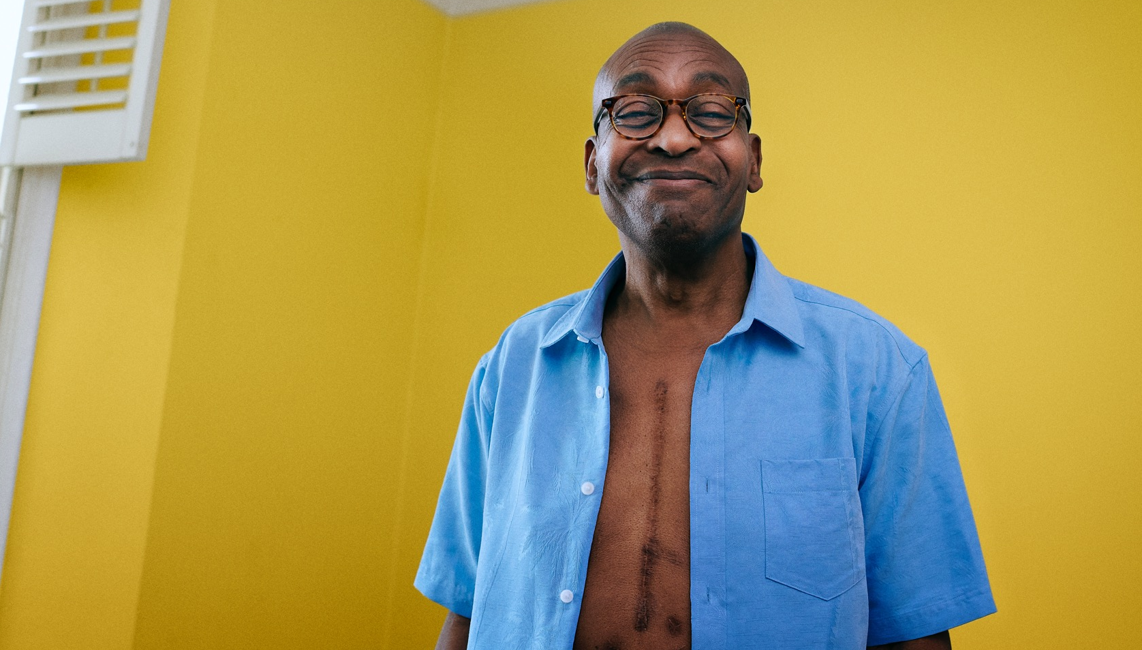
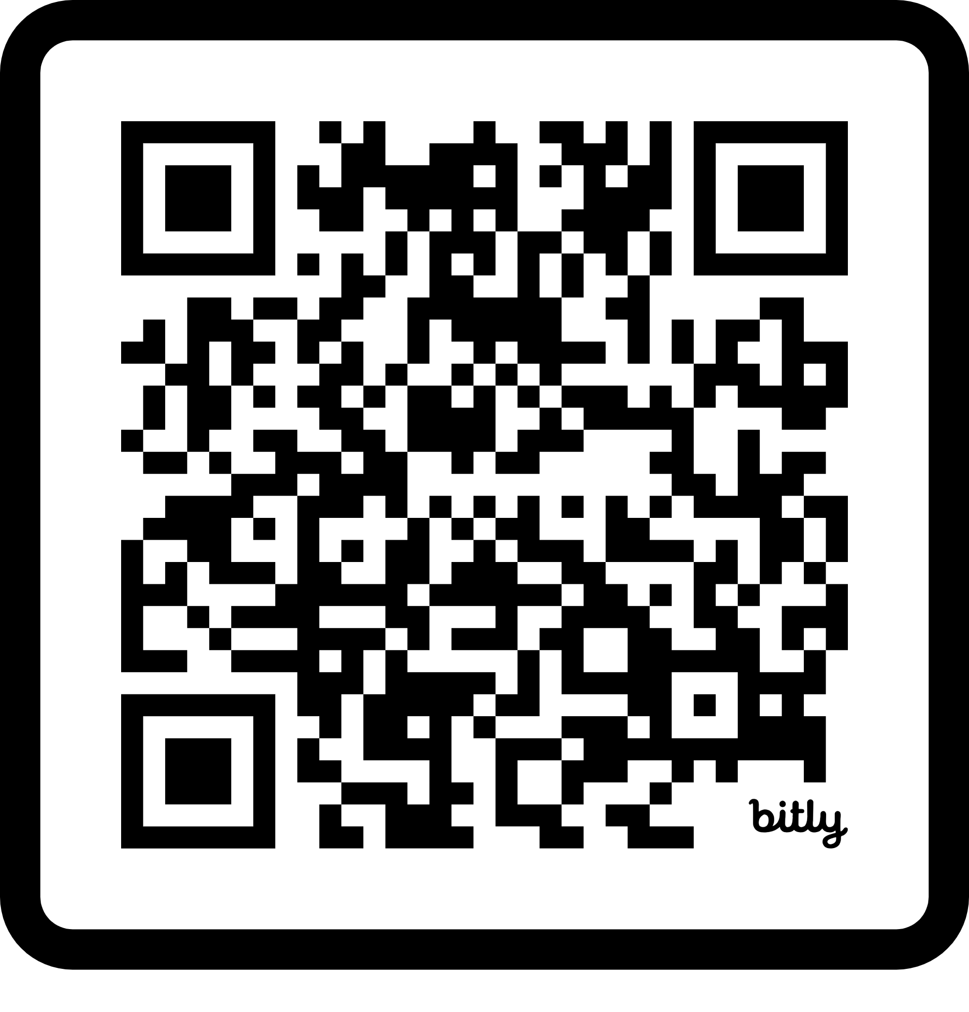
EVERY MOVE
ENABLES MORE.
FIND OUT HOW TO GET MOVING WITH A LONG TERM HEALTH CONDITION
Visit
www.WeAreUndefeatable.co.uk

Slide 2
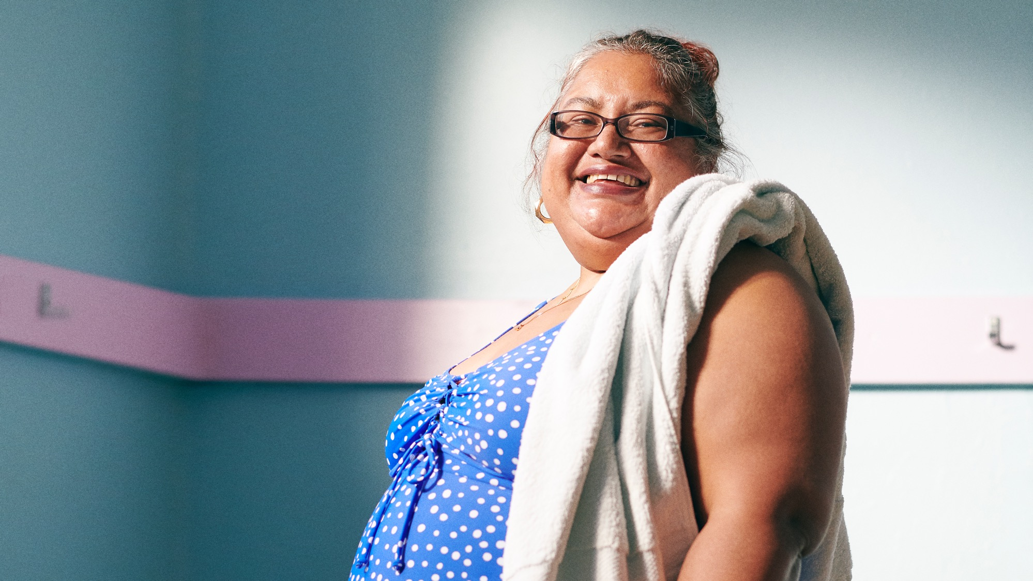
START SLOWLY
AND BUILD UP.
WE ARE UNDEFEATABLE AIMS TO SUPPORT AND ENCOURAGE YOU TO FIND WAYS TO BE ACTIVE THAT CAN WORK FOR YOU AND YOUR HEALTH CONDITION

Slide 3
FIND YOUR WAY TO
MOVE.
www.WeAreUndefeatable.co.uk

